Slide 1


Microwave Oven System Task
By: Mahmoud Saad Abd-Elhares Mahmoud
E-Mail: Mahmoud.S.AbdElhares@gmail.com
LinkedIn: linkedin.com/in/mahmoudsaad96
Git-Hub: https://github.com/ZeroX96

Slide 2
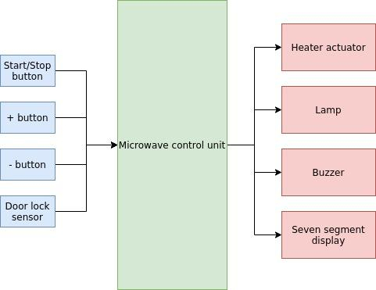
Task: Design and implement an embedded software using FreeRTOS for a microwave oven.

Slide 3
System Requirements:
Buzzer beeps 100ms at each button press.
The heater actuator requires 60% ,50ms period PWM signal in order to be turned on.
When it’s powered on : a. Buzzer beeps 100ms b. Seven segment display is initialized with zeros | When heating is off : a. + and - buttons are used to set the required heating time with 5 second step b. Lamp is: i. on when door is open ii. off when door is closed c. Seven segment displays the time setting while blinking 300ms on and 300ms off after the first change from zeros d. Start/stop button start heating only if door is closed
When heating is done: a. lamp is off b. Heater is off c. Buzzer beeps two times 100ms on and 100ms off | When heating is on: a. + button is used to increment the required heating time with 5 second step b. Seven segment displays time remaining (no blinking) c. lamp is on d. Heater is on e. Start/stop button stop heating

Slide 4
System Assumptions:
The System-Tick is set to be 5ms each. a. To Achieve the illusion to the human eyes displaying the time settings on the SSD while Multiplexing b. The buzzer beeps 100ms, The system 7-Segments are Blinked ever 300ms, and, The usual user button pressing time is about 100ms, and all of them are divisible by the SysTick Value of 5. c. So, to reduce the kernel invocation overhead on the system, the Systick value is set to be 5ms.
The number of Seven-Segments Displays is set to be 4. a. To Give the user a good range from 0-Seconds up to N-Seconds, N is defined in the header-file.
3) The PWM signal that will be driving the heater, will be working at a frequency of 20-hz. a. Given the required period to enable the Heater to be 50-ms.
4) The Buttons Scanning Rate is set to be once every 20ms. And, 2-Samples are got to ensure a user press. a. Given the usual user press time is about 100ms, scanning every 20ms is enough and to reduce the overhead.
5) The Time Counter is based on seconds and don’t follow the hour/minute/second scheme a. For example 12:34 not equal 12 minutes but, 1234 Seconds
6) If the door gets opened while heating is ON, the Heater is Turned-Off, Lamp is Turned-On and System is PAUSED a. If Door is Open while Heating is OFF, Lamp is Turned-On (as Given in the document) b. If Door is Open while Heating is ON, Heater is Turned-Off and Lamp is Turned-On (the Assumption) c. While the system is paused, if the door is closed, system continues. d. While the system is paused, If start button is pressed, the system is turned-off.

Slide 5
Microwave: Static Architecture
“Assuming the Door Sensor is just another button in the system”
Microwave
Heater
Start/Stop
OS
PWM
Lamp
+
Buttons
Scheduling
Lamp
Buzzer
Buzzer
Time
-
DISP
SevSeg
DoorSensor
µWave
SSD

Slide 6
Microwave: Detailed Static Design
OS
xTaskCreate
vTaskStartScheduler
xTaskGetTickCount
vTaskDelayUntil
vTaskDelete
Buzzer
BuzzInit
BuzzSetState
BuzzUpdate
Microwave
MicroWaveInitState
MicroWaveSetState
MicroWaveGetState
TIME
TimeInit
TimeIncTime / TimeDecTime
TimeSetTime / TimeGetTime
TimePauseTime / TimeResumeTime
TimeUpdate
Heater
HeaterInit
HeaterSetState
HeaterGetState
HeaterUpdate
PWM
PwmInit
PwmRun
PwmStop
PwmDeInit
Buttons & Door
BtnInit
DoorSensInit
BtnGetState
DoorSensGetState
BtnUpdate
DoorSensUpdate
DISP
DispInit
DispSetVal
DispUpdate
SSD
DisplayInit
DisplayWrite
DisplayReset
DisplayDeInit
DisplayMuxInit
DisplayMuxWrite
DisplayMuxReset
DisplayMuxDeInit
Lamp
LampInit
LampSetState
LampGetState
LampUpdate

Slide 7
Needed Files for The Project
µWave
µWave
µController
Modules
Main.c
µWave.c
Main.h
Time
Buttons
Lamp
Buzzer
Heater
DISP
Time.h
Time.c
Buttons.h
Buttons.c
Lamp.h
Lamp.c
Buzzer.h
Buzzer.c
Heater.h
Heater.c
DISP.h
DISP.c
GPIO
PWM
SSD
GPIO.h
GPIO.c
PWM.h
PWM.c
SSD.h
SSD.c

Slide 8
Microwave: Project Partitioning
Following the Divide and Conquer Algorithm.
Dividing and Conquering is based on:
Functions Periodicity and Time-Cohesion.
Functions Nature (IO Bound – CPU Bound).
Divide and Conquer
Modules | Nature |  | Periodicity | Task/Group
Buttons | IO Bound | Input | 20 ms | INPUTS TSK
Time | CPU Bound | Timing | 1000 ms | TIME TASK
Heater – Lamp - Buzzer | IO Bound | Output | 10 ms | OUTPUTS TASK
Display | IO Bound | Output | 5 ms | DISPLAY TASK

Slide 9
Microwave:
Dynamic Design and Schedulability Check
DISP Task @ 5 ms
TIME Task @ 1000 ms
INPUTS Task @ 20 ms
OUTPUTS Task @ 10 ms
Major Cycle: 1000 ms.
Time
0
5
10
15
20
25
30

Slide 10
Microwave: Dynamic Design and
Priorities Assignment
Following RMS Scheduling in assigning Task Priorities
Rate (Once Every) | Priority | Task
1000 (ms) | Lowest | TIME
20 (ms) | Lower | INPUTS
10 (ms) | Higher | OUTPUTS
5 (ms) | Highest | DISP
Rate Monotonic Scheduling, RMS:
The tasks with the highest frequencies, are given the highest priorities.
DISP Task @ 5 ms
TIME Task @ 1000 ms
INPUTS Task @ 20 ms
OUTPUTS Task @ 10 ms
Major Cycle: 1000 ms.
Time
0
5
10
15
20
25
30

Slide 11
Microwave : Timing Analysis
0- The System is running at 8-MHz with nearly all the instructions takes one or two clock-cycles.
1- I Have No Delays inside all the Tasks and the Modules in the System hence, Nearly all tasks
Execution Time = 0 ms.
Task | Actions | BCET (ms) | WCET(ms) | Period of Action(ms) | Period of task (ms)
Time | Update Time Update System state | ~0 ~0 | ~0 ~0 | 1000 1000 | 1000
Inputs | Update Switches States Update System State | ~0 ~0 | ~0 ~0 | 20 20 | 20
Outputs | Update Outputs | ~0 | ~0 | 10 | 10
Display | Update SSD | ~0 | ~0 | 5 | 5
Tick (ms) |  |  |  |  | 5
Major Cycle (ms) |  |  |  |  | 1000

Slide 12
System State Machine
Graphical Representation
System STARTUP
Start/Stop Button is Pressed
and
Ensured time is set and door is closed
Cocking ON
Cocking OFF
System Initialized
Start/Stop Button is Pressed
Door is
opened
Door is Closed
System Reset
Cocking DONE
Heating
done
Cocking PAUSED
Start/Stop Button is Pressed

Slide 13
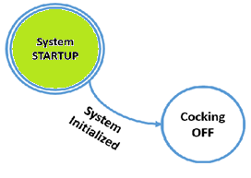
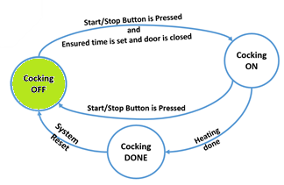
State: System Startup
The initial state that the system wakes-up to.
The system shows all zeros on the display
The system buzzer beebs for 10ms.
The heater is turned-off.
The lamp is turned-off.
State: System Cocking-OFF
The default state that the system stays in after startup, after finishing the cocking operation, or after a Start/Stop Button Pressed while the system was running.
The system shows the current time settings value on the display.
The system buzzer beebs for 10ms.
The heater is turned-off.
The lamp is turned-off.

Slide 14
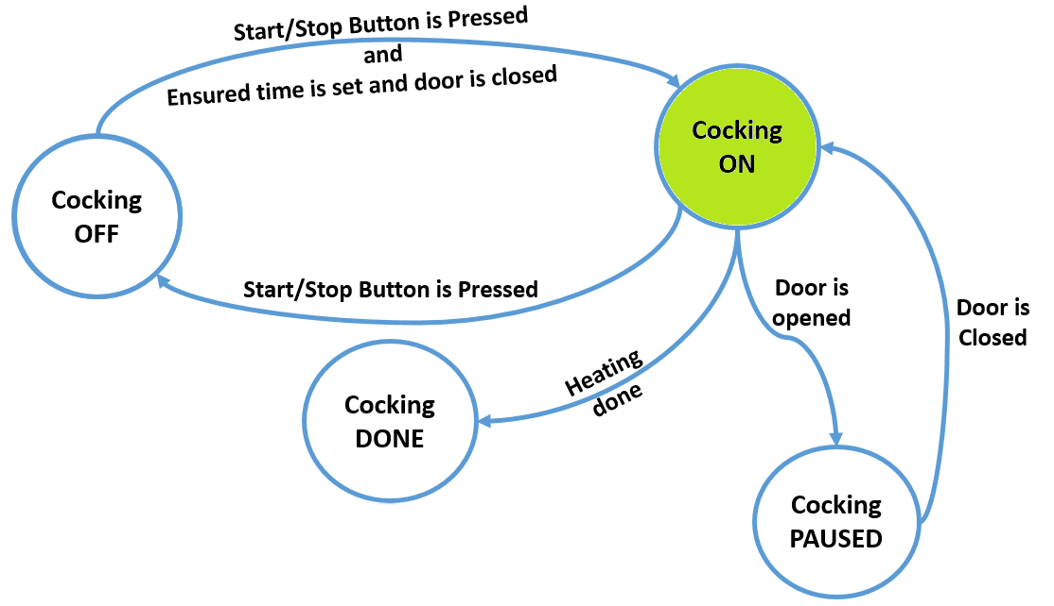
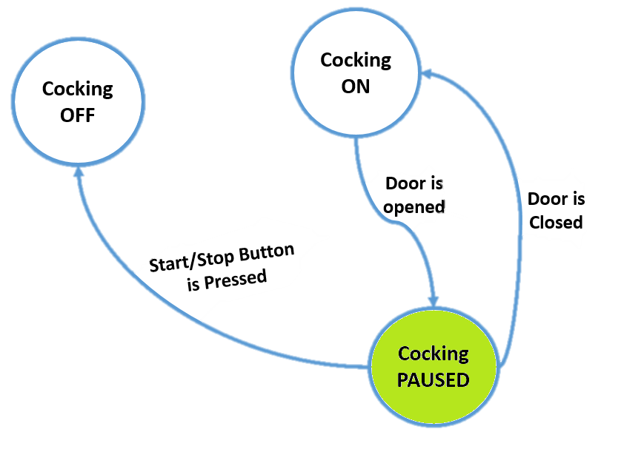
State: System Cocking-ON
The state that the system performs its main task during it.
The system shows the remaining-time for the cocking to be done on the display
The system responds only to the + Button and neglects the - Button.
The heater is turned-on.
The lamp is turned-on.
State: System Cocking-Paused
The state of the system if the door is opened while cocking is going on.
It stays hear as long as the door is opened or the Start/Stop button is pressed.
The system shows the current time value on the display.
The system timing is paused
The heater is turned-off.
The lamp is turned-off If the door is closed or it’s turned-on if door is opened.

Slide 15
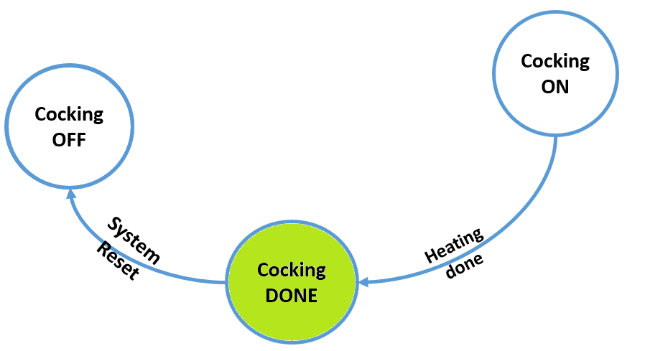
State: System Cocking-Done
The state that the system goes through after finishing the cocking operation.
The system shows the current time value on the display.
The system buzzer beebs two times for 100ms ON and 100ms OFF.
The heater is turned-off.
The lamp is turned-off.
The system is reset and goes back to the cocking-off state.

Slide 16
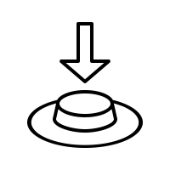
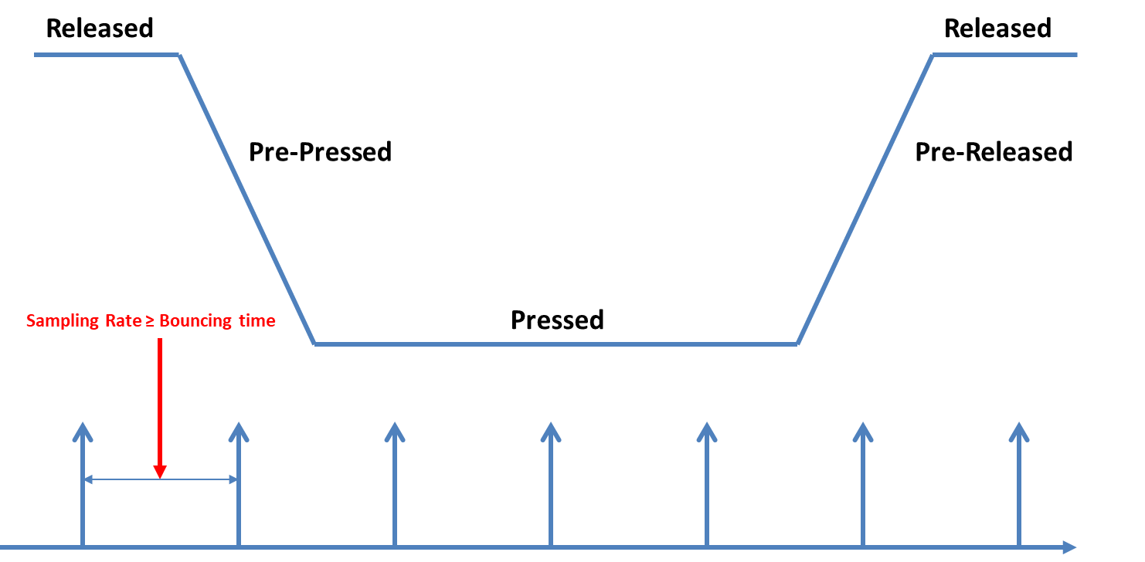
System Modules and Functions: Buttons
Handles the system buttons and the resulting states.
Module Buttons
Function | Type
void BtnInit(BtnSelectT BtnSelect, BtnStateT BtnInitState); | Initialization
BtnStateT BtnGetState(BtnSelectT BtnSelect); | Global Function
void BtnUpdate(void ); | Periodic Function

Slide 17
System Modules and Functions: Buttons
void BtnInit(BtnSelectT BtnSelect, BtnStateT BtnInitState);
Function initializes the hardware for the system buttons
BtnSelect | Defines which button to initialize
BtnInitState | Defines the initial state for the targeted button
Return | NON, Void
BtnStateT BtnGetState(BtnSelectT BtnSelect)
Function gets the current state of the targeted button
BtnSelect | Defines which button to get its state
Return | returns the state of the targeted button
void BtnUpdate(void )
Function updates the current state of all the buttons
Return | NON, Void

Slide 18

System Modules and Functions: Time
Handles the system timer set by user to cock the food.
Module Time
Function | Type
void TimeInit(void); | Initialization
void TimeIncTime(void); | Global Function
void TimeDecTime(void); | Global Function
void TimeSetTime(uint16_t TimeVal); | Global Function
void TimeResumeTime(void); | Global Function
void TimePauseTime(void); | Global Function
uint16_t TimeGetTime(void); | Global Function
void TimeUpdate(void); | Periodic Function

Slide 19
System Modules and Functions: Time
void TimeInit(void);
Function initializes the software for the system timer
Return | NON, Void
void TimeIncTime(void);
Function increments the system timer with step of 5 s
Return | NON, Void
void TimeDecTime(void);
Function decrements the timer variable with step of 5 s
Return | NON, Void
void TimeSetTime(uint16_t TimeVal);
Function updates the timer value as needed by TimeVal
TimeVal | the required value to be set as the system time
Return | NON, Void

Slide 20
System Modules and Functions: Time
uint16_t TimeGetTime(void);
Function returns the system timer variable current value
Return | the value of the current system time variable
void TimeResumeTime(void);
Function resumes the timer variable and module operation
Return | NON, Void
void TimePauseTime(void);
Function pauses the timer variable and module operation
Return | NON, Void
void TimeUpdate(void);
Function updates the timer variable current value and handles the system mode of cocking when cocking is done
Return | NON, Void

Slide 21
System Modules and Functions: DISPLAY
Handles the Multiplexed system Seven-Segment Display
Module Display
Function | Type
void DispInit(void); | Initialization
void DispSetVal(uint16_t DataVal); | Global Function
void DispUpdate(uint8_t Id); | Periodic Function

Slide 22
System Modules and Functions: DISPLAY
void DispInit(void);
Function initializes the hardware for the system Display
Return | NON, Void
void DispSetVal(uint16_t DataVal);
Function updates the Display value as needed by DataVal
DataVal | Defines the value to be presented on the display
Return | NON, Void
void DispUpdate(uint8_t Id);
Function updates the display data current shown on the segments
Id | defines which seven segment to turn on and show the data on
Return | NON, Void

Slide 23
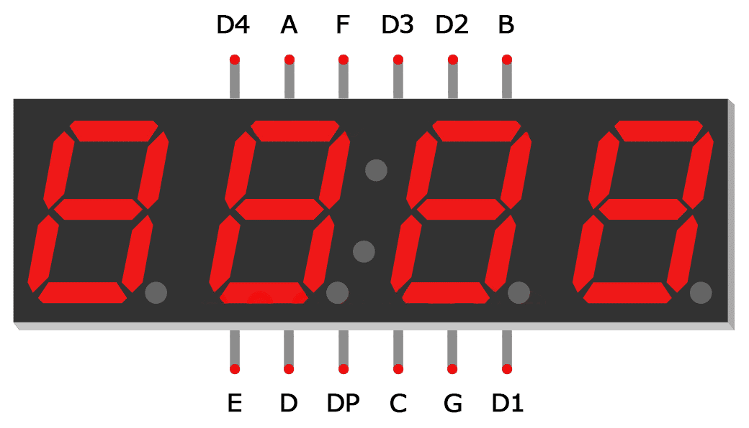
System Modules and Functions: SSD
Handles the system Seven Segment Displays
Module SSD
Function | Type
SevenSegRetT DisplayInit(SevenSegT* Display, GpioBaseT DispPort,SevenSegTypeT DispType); | Initialization
SevenSegRetT DisplayWrite(SevenSegT* Display,uint8_t OutVal); | Global Function
SevenSegRetT DisplayReset(SevenSegT* Display); | Global Function
SevenSegRetT DisplayDeInit(SevenSegT* Display); | Global Function
SevenSegRetT DisplayMuxInit(SevenSegT* Display,GpioBaseT DataPort,GpioBaseT CtrlPort,SevenSegTypeT DispType); | Global Function
SevenSegRetT DisplayMuxWrite(SevenSegT* Display, uint8_t OutDataVal[], uint8_t DispId); | Global Function
SevenSegRetT DisplayMuxReset(SevenSegT* Display); | Global Function
SevenSegRetT DisplayMuxDeInit(SevenSegT* Display); | Global Function

Slide 24
System Modules and Functions: SSD
SevenSegRetT DisplayInit(SevenSegT* Display, GpioBaseT DispPort,SevenSegTypeT DispType);
Function initializes the hardware for the system display
Display | Pointer to the display handler that leads to the display
DispPort | Which port is the display connected to on the controller
DispType | Defines which type is the display, Common Anode-Cathode
Return | State of the initialization process
SevenSegRetT DisplayWrite(SevenSegT* Display,uint8_t OutVal);
Function updates the currently presented data on the display by the OutVal
Display | Pointer to the display handler that leads to the display
OutVal | The value that will be presented on the display
Return | State of the writing process

Slide 25
System Modules and Functions: SSD
SevenSegRetT DisplayReset(SevenSegT* Display);
Function Resets the currently presented value to zero
Display | Pointer to the display handler that leads to the display
Return | The state of the reseting process
SevenSegRetT DisplayDeInit(SevenSegT* Display);
Function un-initializes the display Module
Display | Pointer to the display handler that leads to the display
Return | The state of de-initialization process
SevenSegRetT DisplayMuxInit(SevenSegT* Display,GpioBaseT DataPort,GpioBaseT CtrlPort,SevenSegTypeT DispType);
Function initializes the hardware for the Multiplexed system display
Display | Pointer to the display handler that leads to the display
DataPort | Which port is the display connected to on the controller
CtrlPort | Which port is the display connected to on the controller
DispType | Defines which type is the display, Common Anode-Cathode
Return | State of the initialization process

Slide 26
System Modules and Functions: SSD
SevenSegRetT DisplayMuxWrite(SevenSegT* Display, uint8_t OutDataVal[], uint8_t DispId);
Function updates the currently presented data on the display by the OutDataVal
Display | Pointer to the display handler that leads to the display
OutDataVal | The value that will be presented on the display
DispId | defines which seven segment to turn on and show the data on
Return | State of the writing process
SevenSegRetT DisplayMuxReset(SevenSegT* Display);
Function Resets the currently presented value to zero
Display | Pointer to the display handler that leads to the display
Return | State of the initialization process
SevenSegRetT DisplayMuxDeInit(SevenSegT* Display);
Function un-initializes the display Module
Display | Pointer to the display handler that leads to the display
Return | State of the initialization process

Slide 27

System Modules and Functions: Buzzer
Handles the system Buzzer that’s used to notify the user.
Module Buzzer
Function | Type
void BuzzInit(BuzzSelectT BuzzSelect, BuzzStateT BuzzInitState); | Initialization
void BuzzSetState(BuzzSelectT BuzzSelect, BuzzStateT BuzzState, int16_t Duration); | Global Function
void BuzzUpdate(void ); | Periodic Function

Slide 28
System Modules and Functions: Buzzer
void BuzzInit(BuzzSelectT BuzzSelect, BuzzStateT BuzzInitState);
Function initializes the hardware for the system buzzer
BuzzSelect | Defines which Buzzer to initialize
BuzzInitState | Defines the initial state for the targeted Buzzer
Return | NON, Void
void BuzzSetState(BuzzSelectT BuzzSelect, BuzzStateT BuzzState, int16_t Duration);
Function sets the state of the targeted buzzer for a specified duration
BuzzSelect | Defines which button to set its state
BuzzState | Defines the state for the targeted Buzzer
Duration | Defines the duration needed to put the buzzer in the new state
Return | NON, Void
void BuzzUpdate(void );
Function updates the current state of all the buttons
Return | NON, Void

Slide 29

System Modules and Functions: Lamp
Handles the system Lamp that’s used to Light up the system.
Module Lamp
Function | Type
void LampInit(LampSelectT LampSelect, LampStateT LampInitState); | Initialization
void LampSetState(LampSelectT LampSelect, LampStateT LampState); | Global Function
BtnStateT LampGetState(LampSelectT LampSelect); | Global Function
void LampUpdate(void ); | Periodic Function

Slide 30
System Modules and Functions: Lamp
void LampInit(LampSelectT LampSelect, LampStateT LampInitState);
Function initializes the hardware for the system Lamps
LampSelect | Defines which Lamp to initialize
LampInitState | Defines the initial state for the targeted Lamp
Return | NON, Void
void LampSetState(LampSelectT LampSelect, LampStateT LampState);
Function sets the state of the targeted Lamp
LampSelect | Defines which Lamp to set its state
LampState | Defines the state for the targeted Lamp
Return | NON, Void
BtnStateT LampGetState(LampSelectT LampSelect);
Function sets the state of the targeted Lamp
LampSelect | Defines which Lamp to get its state
Return | Returns the current state for the targeted Lamp

Slide 31
System Modules and Functions: Lamp
void LampUpdate(void );
Function updates the current state of all the Lamps in the system
Return | NON, Void

Slide 32
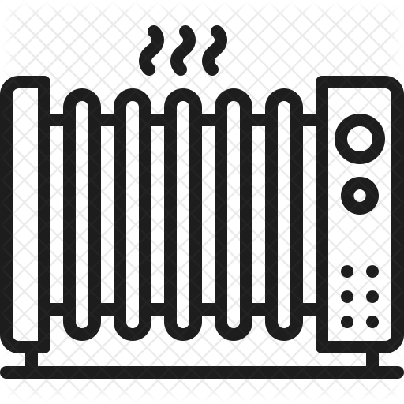
System Modules and Functions: Heater
Handles the system Heaters.
Module Heater
Function | Type
void HeaterInit(HeaterSelectT HeaterSelect, HeaterStateT HeaterState); | Initialization
void HeaterSetState(HeaterSelectT HeaterSelect, HeaterStateT HeaterState); | Global Function
HeaterStateT HeaterGetState(HeaterSelectT HeaterSelect); | Global Function
void HeaterUpdate(void ); | Periodic Function

Slide 33
System Modules and Functions: Heater
void HeaterInit(HeaterSelectT HeaterSelect, HeaterStateT HeaterState);
Function initializes the hardware for the system heater
HeaterSelect | Defines which heater to initialize
HeaterState | Defines the initial state for the targeted heater
Return | NON, Void
void HeaterSetState(HeaterSelectT HeaterSelect, HeaterStateT HeaterState);
Function sets the state of the targeted heater
LampSelect | Defines which heater to set its state
LampState | Defines the state for the targeted heater
Return | NON, Void

Slide 34
System Modules and Functions: Heater
HeaterStateT HeaterGetState(HeaterSelectT HeaterSelect);
Function sets the state of the targeted heater
LampSelect | Defines which heater to get its state
Return | Returns the current state for the targeted heater
void HeaterUpdate(void );
Function updates the current state of all the Heaters in the system
Return | NON, Void

Slide 35

System Modules and Functions: PWM
Handles the system PWM Driver used to handle the System Heaters.
Module PWM
Function | Type
PwmRetT PwmInit(PwmT* Pwm, PwmBaseT PwmBase, PwmOutputModeT PwmOutputMode, PWmDutyCycleT PWmDutyCycle, PwmOperatingModeT PwmOperatingMode, uint32_t PwmFrequency); | Initialization
PwmRetT PwmRun(PwmT* Pwm); | Global Function
PwmRetT PwmStop(PwmT* Pwm); | Global Function
PwmRetT PwmDeInit(PwmT* Pwm); | Global Function

Slide 36
System Modules and Functions: PWM
PwmRetT PwmInit(PwmT* Pwm, PwmBaseT PwmBase, PwmOutputModeT PwmOutputMode, PWmDutyCycleT PWmDutyCycle, PwmOperatingModeT PwmOperatingMode, uint32_t PwmFrequency);
Function initializes the hardware for the system PWM
Pwm | Pointer to the PWM Module handler that controls the heater
PwmBase | Which PWM source is the heater connected to on the controller
PwmOutputMode | Defines the output mode of the Signal if Inverted or not
PWmDutyCycle | Defines the duty cycle needed from the pwm driver on the source
PwmOperatingMode | Defines the operating mode if it’s Phase-correct or Fast PWM
PwmFrequency | The frequency needed that the output signal to be operating on
Return | State of the initialization process

Slide 37
System Modules and Functions: PWM
PwmRetT PwmRun(PwmT* Pwm);
Function enables the signal to be output on the signal pin and connected to the heater
Pwm | Pointer to the PWM Module handler that controls the heater
Return | State of the Runing process
PwmRetT PwmStop(PwmT* Pwm);
Function disables the signal to be output on the signal pin and connected to the heater
Pwm | Pointer to the PWM Module handler that controls the heater
Return | State of the Stopping process
PwmRetT PwmDeInit(PwmT* Pwm);
Function un-initializes the hardware module that generates the pwm signal connected to the heater
Pwm | Pointer to the PWM Module handler that controls the heater
Return | State of the un-initialization process

Slide 38
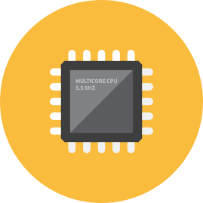
System Modules and Functions: GPIO
Handles the system GPIO Driver used to handle the System Inputs & Outputs.
Module GPIO
Function | Type
GpioRetT GpioInitPort(GpioBaseT Base,GpioStateT State); | Initialization
GpioRetT GpioInitPin(GpioBaseT Base,GpioPinT Pin,GpioStateT State); | Global Function
GpioRetT GpioWritePort(GpioBaseT Base,uint8_t Val); | Global Function
GpioRetT GpioWriteGroup(GpioBaseT Base,uint8_t Val,uint8_t Len,uint8_t FirstBit); | Global Function
GpioRetT GpioWritePin(GpioBaseT Base,GpioPinT Pin,GpioStateT State); | Global Function
uint8_t GpioReadPort(GpioBaseT Base); | Global Function
uint8_t GpioReadGroup(GpioBaseT Base, uint8_t Len, uint8_t FirstBit); | Global Function
uint8_t GpioReadPin(GpioBaseT Base,GpioPinT Pin); | Global Function

Slide 39
System Modules and Functions: GPIO
GpioRetT GpioInitPort(GpioBaseT Base,GpioStateT State);
Function initializes the hardware for the system Ports
Base | Defines which gpio port to initialize
State | State of the Targeted port
Return | State of the initialization process
GpioRetT GpioInitPin(GpioBaseT Base,GpioPinT Pin,GpioStateT State);
Function initializes the hardware for the system Pins
Base | Defines which gpio port to initialize
Pin | Defines which pin on that port to set its state
State | State of the Targeted pin to be set
Return | State of the initialization process

Slide 40
System Modules and Functions: GPIO
GpioRetT GpioWritePort(GpioBaseT Base,uint8_t Val);
Function initializes the hardware for the system Pins and Ports
Base | Defines which gpio port to write to
Val | Value to be written on that port
Return | State of the writing process
GpioRetT GpioWriteGroup(GpioBaseT Base,uint8_t Val,uint8_t Len,uint8_t FirstBit);
Function initializes the hardware for the system Pins
Base | Defines which gpio port to write to
Val | Defines the value to be writen
Len | Defines the length of the targeted group
FirstBit | defines the starting bit of the group needed to be writen
Return | State of the writing process

Slide 41
System Modules and Functions: GPIO
GpioRetT GpioWritePin(GpioBaseT Base,GpioPinT Pin,GpioStateT State);
Function initializes the hardware for the system Pins and Ports
Base | Defines which gpio port to write to
Pin | The targeted pin to be writen
State | State of the Targeted pin to be set
Return | State of the initialization process
uint8_t GpioReadPort(GpioBaseT Base);
Function initializes the hardware for the system Pins
Base | Defines which gpio port to read from
Return | State of the Targeted port

Slide 42
System Modules and Functions: GPIO
uint8_t GpioReadGroup(GpioBaseT Base, uint8_t Len, uint8_t FirstBit);
Function initializes the hardware for the system Pins and Ports
Base | Defines which gpio port to read from
Len | Defines the length of the targeted group
FirstBit | defines the starting bit of the group needed to be read
Return | State of the Targeted group in a byte to be extracted later
uint8_t GpioReadPin(GpioBaseT Base,GpioPinT Pin);
Function reads the hardware state of the targeted pin
Base | Defines which gpio port to read from
Pin | Defines which pin on that port to get its state
Return | State of the Targeted Pin

Slide 43
___Done___
Mahmoud Saad Abd-Elhares
Mahmoud.S.AbdElhares@gmail.com
Linkedin.com\in\MahmoudSaad96
Github.com\ZeroX96

